Slide 1

WEB SCRAPING
BY:- PARMESHWARA JOGA
ENROLL NO 19STUCHH010236

Slide 2
CONTENTS
Introduction :-Web Scraping
What is web scraping ? Is web scraping legal ?
Why Web Scraping ?
Prerequisites knowledge
Why is Python Good For Web Scraping?
Basic requirements for web scraping

Slide 3
Code using PyCharm IDE
Using various libraries and functions of each libraries
Different methods to extract data from web pages.
How to store scraped data in files in a specified format ?
Web Scraping Example : Scraping Amazon Website, Car dealers website .

Slide 4
Limitations of web scraping
Major problems that are encountered in web scraping and what can be done ?
Conclusion

Slide 5

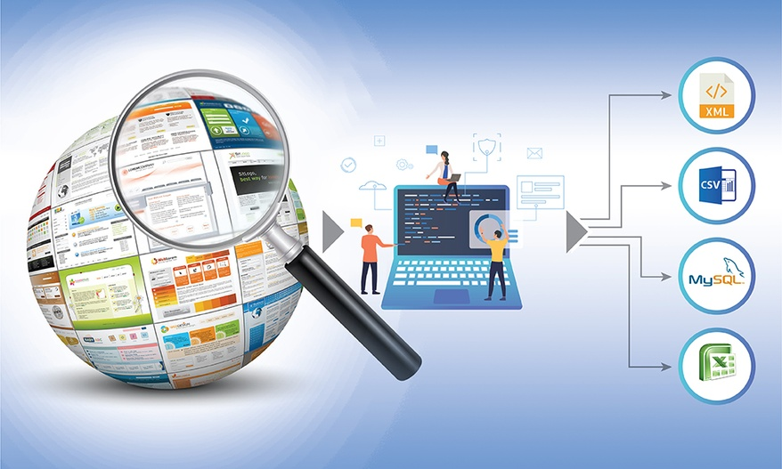
What is Web Scraping ?
Web scraping is the process of using bots to extract content and data from a website. Unlike screen scraping, which only copies pixels displayed onscreen, web scraping extracts underlying HTML code and, with it, data stored in a database.

Slide 6
Why is Web Scraping Used?
03
Social Media Scraping
Web scraping is used to collect large information from websites. But why does someone have to collect such large data from websites?
Web scraping is used to collect data from Social Media websites such as Twitter to find out what’s trending.
04
Research and Development
01
Web scraping is used to collect a large set of data (Statistics, General Information, Temperature, etc.) from websites, which are analyzed and used to carry out Surveys or for R&D.
Price Comparison
Services such as Parse Hub use web scraping to collect data from online shopping websites and use it to compare the prices of products.
05
Job listings
02
Email address gathering
Details regarding job openings, interviews are collected from different websites and then listed in one place so that it is easily accessible to the user.
Many companies that use email as a medium for marketing, use web scraping to collect email ID and then send bulk emails.

Slide 7
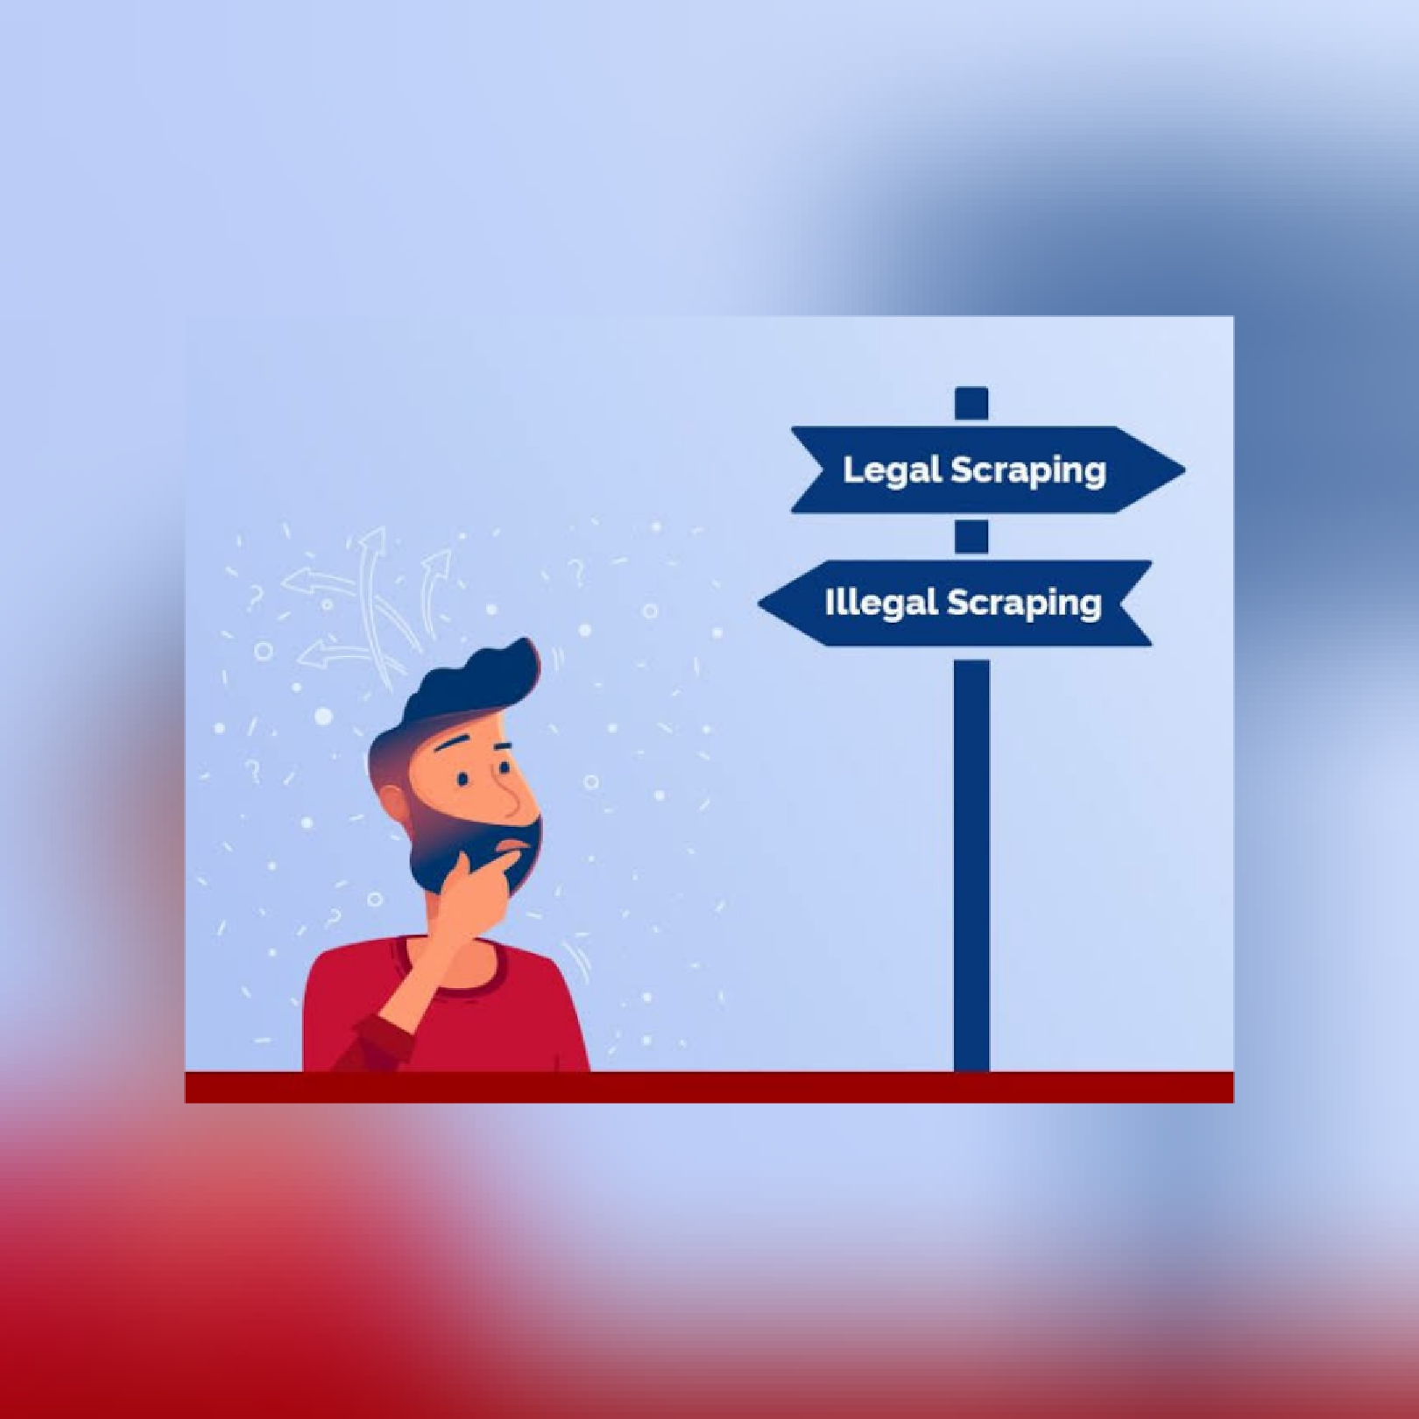
Is Web scraping legal ?
Web scraping and crawling aren’t illegal by themselves. Startups love it because it’s a cheap and powerful way to gather data without the need for partnerships. Big companies use web scrapers for their own gain but also don’t want others to use bots against them.
In this there is a way to know whether the website allows us to scrape the data in it or not for that we have a library in python i.e. is ‘RESPONSE’ which returns the number as output. This number shows whether the website allows us to scrap or not. We also called it as robot.txt method.

Slide 8
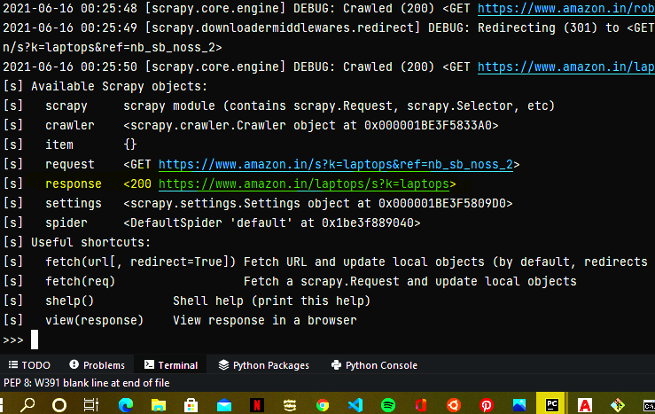
If the response is 200 then the website allows us to scrap the data from it.
this is an example of amazon website which allows for scraping .
The command for checking is scrapy shell “link of the website to be scraped “ . Firstly some of the python libraries and files are needed to be installed.

Slide 9
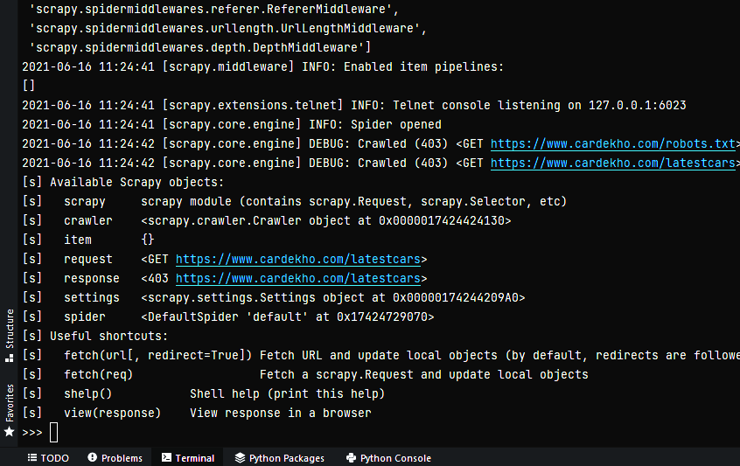
If the response is 403, 404 then the website does not allows us to scrap the data from it.
This is an example of car Dekho website which does not allows for scraping .
The command for checking is scrapy shell “link of the website to be scraped “ . Firstly some of the python libraries and files are needed to be installed.

Slide 10
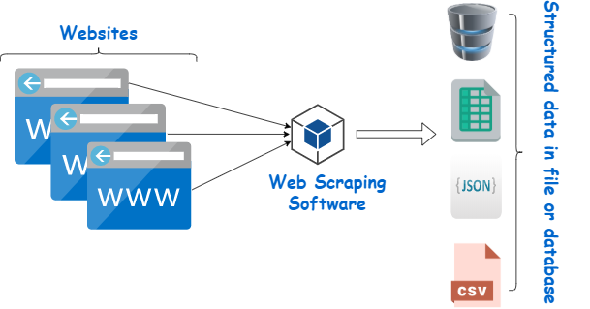
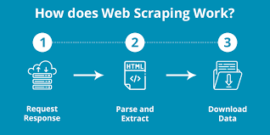
Why python is good for web scraping?
Large Collection of Libraries: Python has a huge collection of libraries such as NumPy, Matplotlib, Pandas etc., which provides methods and services for various purposes. Hence, it is suitable for web scraping and for further manipulation of extracted data.
Dynamically typed: In Python, you don’t have to define datatypes for variables, you can directly use the variables wherever required. This saves time and makes your job faster.
Easily Understandable Syntax: Python syntax is easily understandable mainly because reading a Python code is very similar to reading a statement in English. It is expressive and easily readable, and the indentation used in Python also helps the user to differentiate between different scope/blocks in the code.
Small code, large task: Web scraping is used to save time. But what’s the use if you spend more time writing the code? Well, you don’t have to. In Python, you can write small codes to do large tasks. Hence, you save time even while writing the code.

Slide 11



Applications Used in Web Scraping
PyCharm
Website to be scraped
Data storage application
Python IDE & interpreter
All the webpages with port no 80.
For different formats of data.
It provides us an environment to write the python code, add changes to code and execute the code .
The website from which the data is needed to extracted with the help of program .
For example if the data is huge and needed to be stored in order then csv file type is used to store .

Slide 12

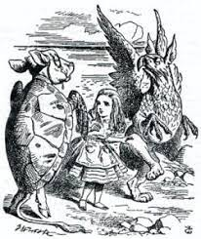


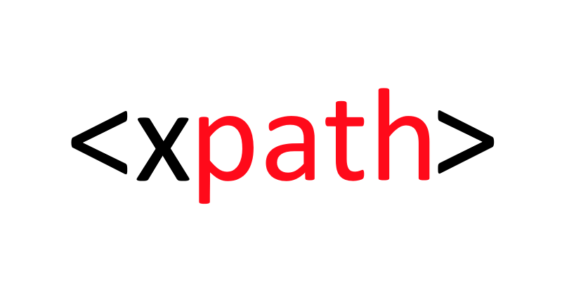
Ways to scrap a website
These are different libraries and editors which can be used for web scarping
Each one has different style and syntax for operation. All of them are supported in python.
These are some of the libraries through which the output can be achieved. We need to install them and create a virtual environment for executing them .
Exp:-scrapy , beautiful soup , requests, CSS selector ,xpath
In this presentation we will be seeing with the help of CSS selector and xpath how to extract the data from the website.
Beautiful soup

Slide 13
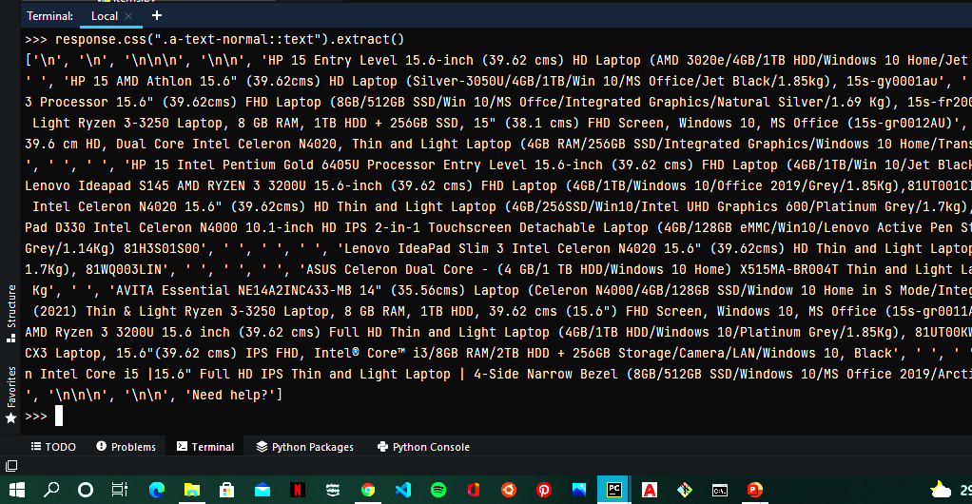
Web scraping through CSS/xpath selector
In this example we have scraped the data from the amazon website about the data related to laptops available with their information. Here we have used the CSS selector to extract data in text format.
And we can see in the terminal whole the data that the corresponding page contains has been scraped and returned in the terminal.
This we have executed in PyCharm by 1st checking the response from the website after that performing this by command
“response.css(“.classnameof data to be extracted::text”).extract()”, /”response.xpath(“//classnameof data to be extracted/text()”).extract()”

Slide 14
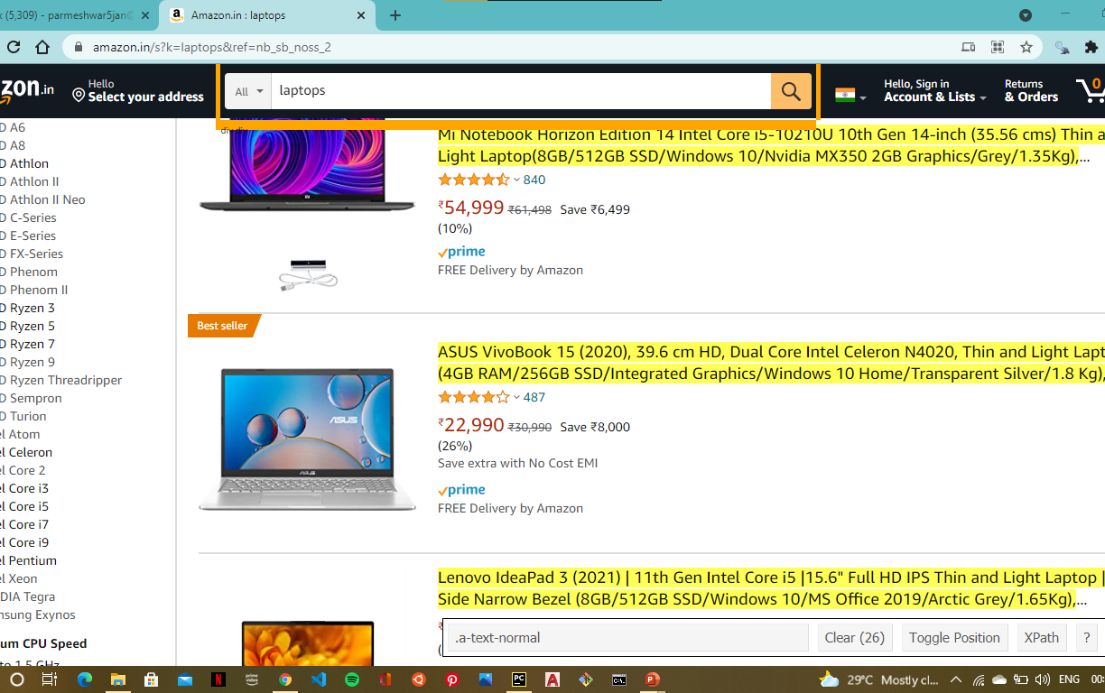
How to select the class for the data
In this it is shown that how to get the class name of the data object. 1st we need to install an extension in the chrome that is “selector tool for chrome”.
And now for what data object we require the html tag class name it will be specified if we select the data with the help of this selector.
Here we have done this in amazon website for collecting the class name of the name of the laptops, and down we get the name of the class there otherwise we can use the inspect button in right click options and explore the html ,CSS code for respective website and find the class name.

Slide 15
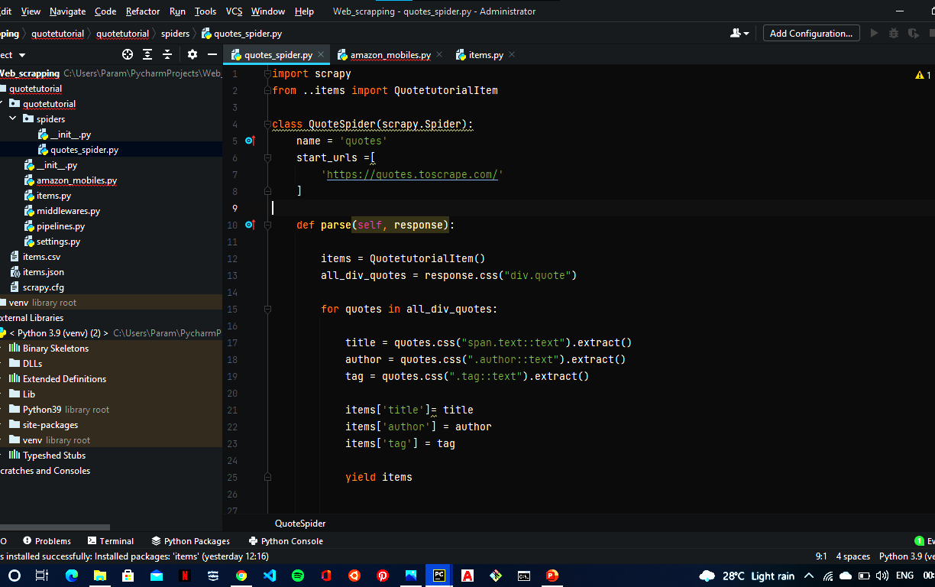
How to save the data in proper format?
In this we will be storing the unordered lists data into a order one. We have many ways for storing the data in a proper valid database. In scrapy we can store the data in various formats such as .json, .csv, .xml files in standard encoding format i.e. UTF-8 .
The command can be executed in the terminal – scrapy crawl “filename” –o items.specifiedformat(csv, xml, json).
Here we use items file which is there in the python project in that items file we create variables that are needed and to store data.

Slide 16


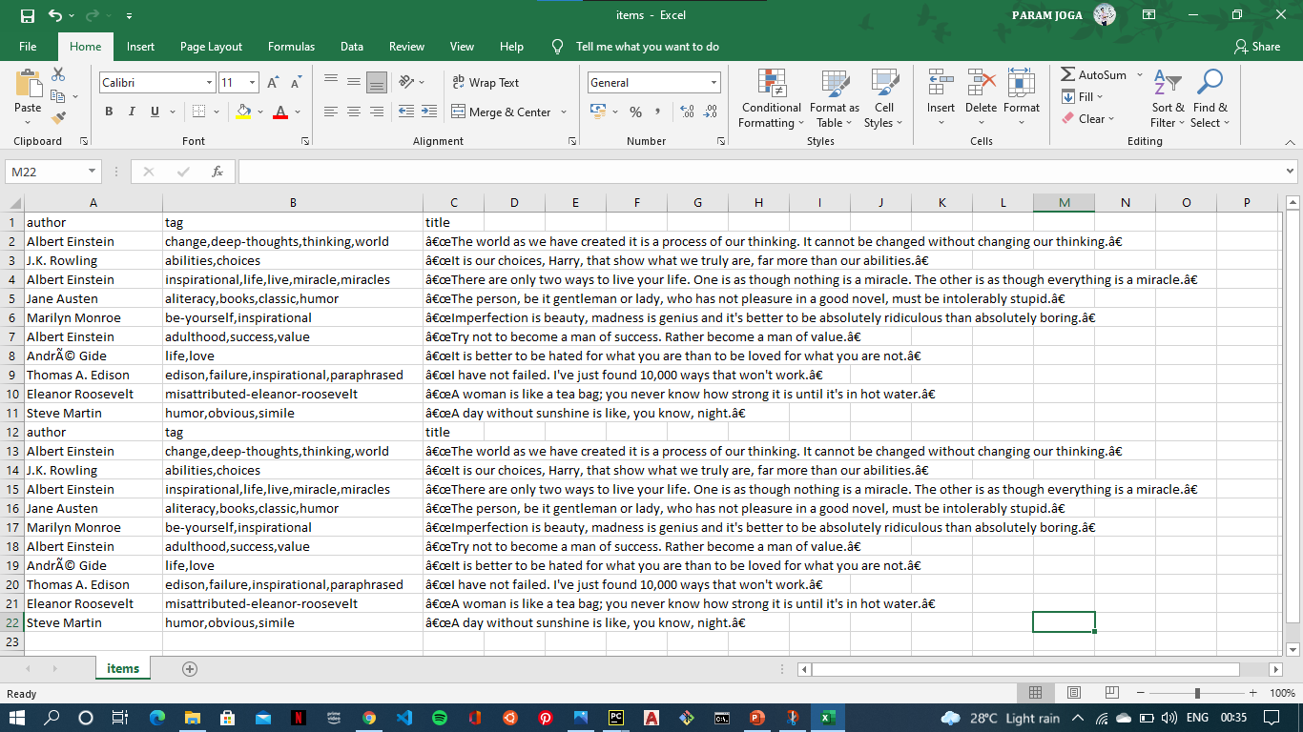
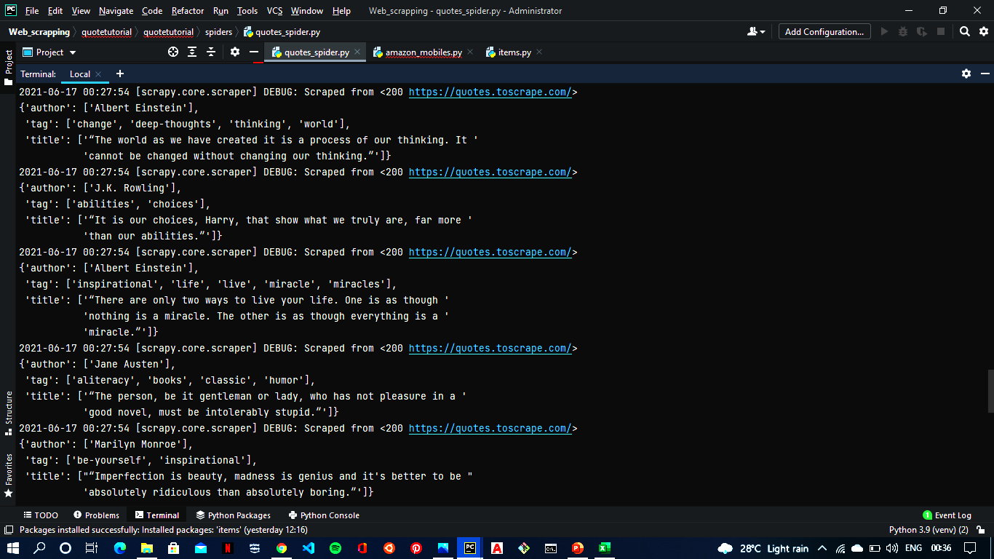
Output in Csv file
Output in terminal

Slide 17
Drawbacks in web scraping
Difficult to analyze – For anybody who is not an expert, the scraping processes are confusing to understand. Although this is not a major problem, but some errors could be fixed faster if it was easier to understand for more software developers.
Data analysis – The data that has been extracted will first need to be treated so that they can be easily understood. In certain cases, this might take a long time and a lot of energy to complete.
Speed and protection policies – Most web scrapping services are slower than API calls and another problem is the websites that do not allow screen scrapping. In such cases web scrapping services are rendered useless. Also, if the developer of the website decides to introduce some changes in the code, the scrapping service might stop working.
Data analysis
Difficult to anaylse
Not supported for all websites

Slide 18




